Slide 1
Installation

Slide 2
What version ???
Ansible’s release cycles are usually about four months long. Due to this short release cycle, minor bugs will generally be fixed in the next release versus maintaining backports on the stable branch. Major bugs will still have maintenance releases when needed, though these are infrequent.
If you are wishing to run the latest released version of Ansible and you are running Red Hat Enterprise Linux (TM), CentOS, Fedora, Debian, or Ubuntu, it is recommend to use the OS package manager.
For other installation options, it is recommend installing via “pip”, which is the Python package manager, though other options are also available.

Slide 3
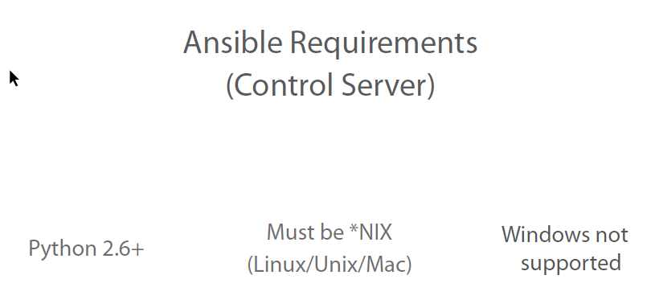
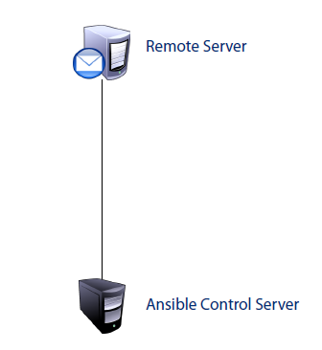

Slide 4
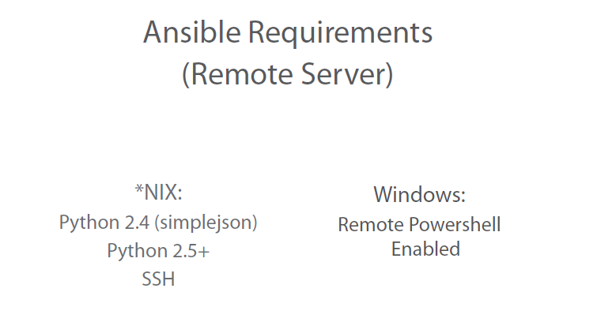

Slide 5
Install using Packages
Ubuntu :
$ sudo apt-get update
$ sudo apt-get install software-properties-common
$ sudo apt-add-repository ppa:ansible/ansible
$ sudo apt-get update
$ sudo apt-get install ansible
Redhat Linux :
yum update
yum install wget
wget https://dl.fedoraproject.org/pub/epel/epel-release-latest-7.noarch.rpm
yum install ./epel-release-latest-*.noarch.rpm
yum install ansible

Slide 6
Install Using PIP
yum update
easy_install pip
pip install ansible

Slide 7
RPM
Ansible will also have RPMs/YUM-repo available.
http://releases.ansible.com/ansible/rpm/
Ansible version 2.4 can manage earlier operating systems that contain Python 2.6 or higher.
You can also build an RPM yourself. From the root of a checkout or tarball, use the make rpm command to build an RPM you can distribute and install.
$ git clone https://github.com/ansible/ansible.git
$ cd ./ansible
$ make rpm
$ sudo rpm -Uvh ./rpm-build/ansible-*.noarch.rpm

Slide 8
Dev Version
If you are looking for the latest development version:
pip install git+https://github.com/ansible/ansible.git@devel

Slide 9
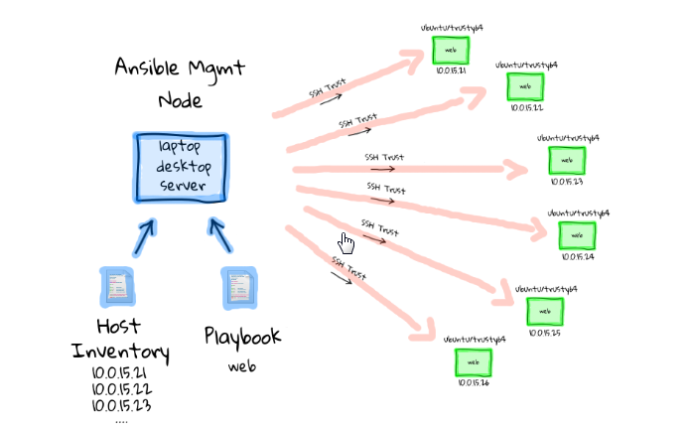
Workflow
Config

Slide 10
Terminology
Module : A programmed unit of work to be done.
Play : A single task from a module, executed on a host or set of hosts
Play-Book : A set of plays built in specific order sequence to produce an expected outcome or outcomes.
Inventory : List of hosts or Hosts groups
Config File : Default Ansible Configuration file.

Slide 11
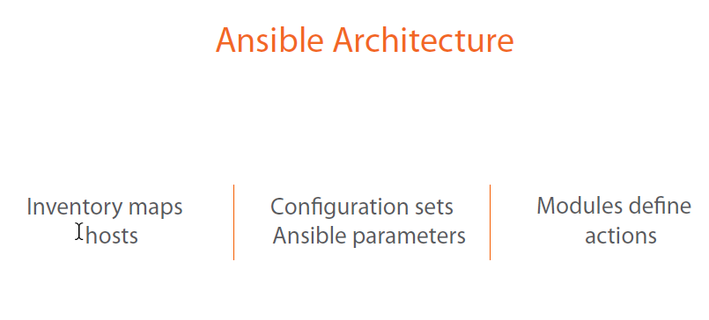

Slide 12
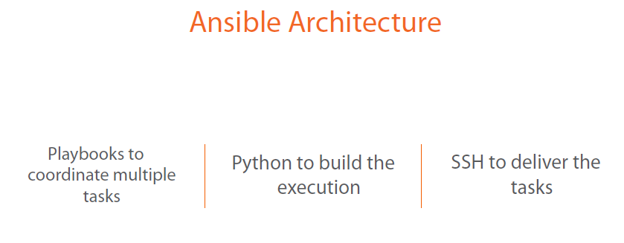

Slide 13
Ansible communicates with remote machines over SSH.
By default, Ansible will try to use native OpenSSH for remote communication when possible. This enables Control Persist (a performance feature), Kerberos, and options in ~/.ssh/config . However, when using Enterprise Linux 6 operating systems as the control machine (Red Hat Enterprise Linux and derivatives such as CentOS), the version of OpenSSH may be too old to support ControlPersist. On these operating systems, Ansible will fallback into using a high-quality Python implementation of OpenSSH called ‘paramiko’. If you wish to use features like Kerberized SSH and more, consider using Fedora, OS X, or Ubuntu as your control machine until a newer version of OpenSSH is available for your platform.
When speaking with remote machines, Ansible by default assumes you are using SSH keys. SSH keys are encouraged but password authentication can also be used where needed by supplying the option --ask-pass. If using sudo features and when sudo requires a password, also supply --ask-become-pass (previously --ask-sudo-pass which has been deprecated).

